Slide 1
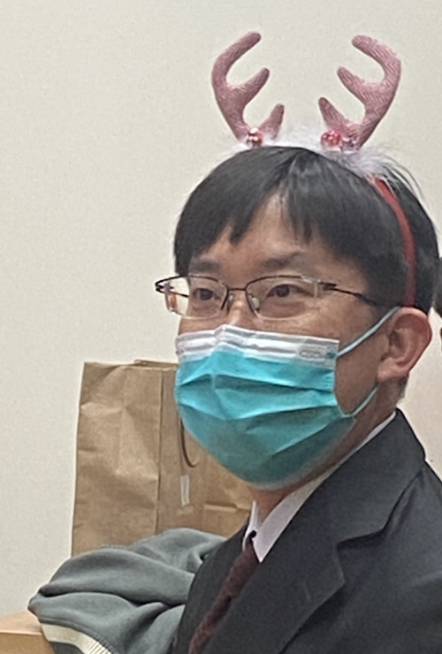
CV Final
Pupil Tracking
sychien我的超人
r10943117 陳昱仁
r10943019 李奕勳
b07901187 宋家齊

Slide 2
Outline
Result
Model architecture
Segmentation
Confidence
Loss function
Data processing
Pre-process
Data augmentation
Post-process
Challenge dataset
Reference

Slide 3
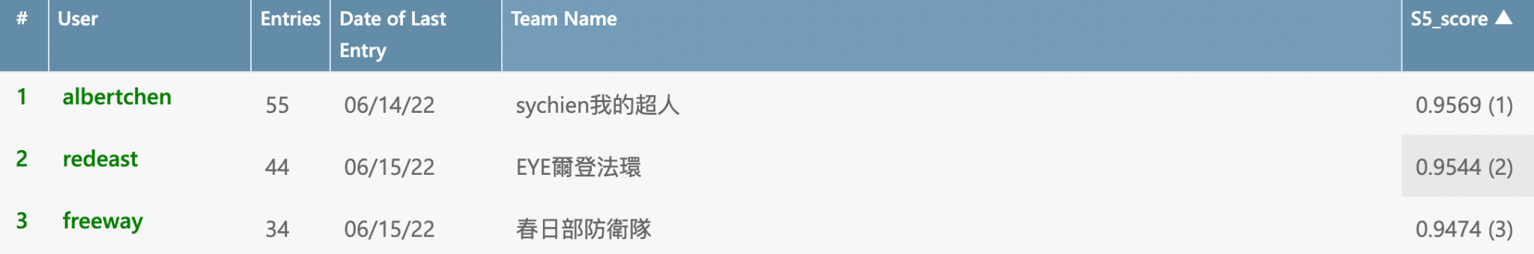
Result
Rank 1
S5 score: 0.9569
Overall weighted IoU: 0.9429
Average true negative rate: 0.9897
Benchmark score: 0.9569

Slide 4
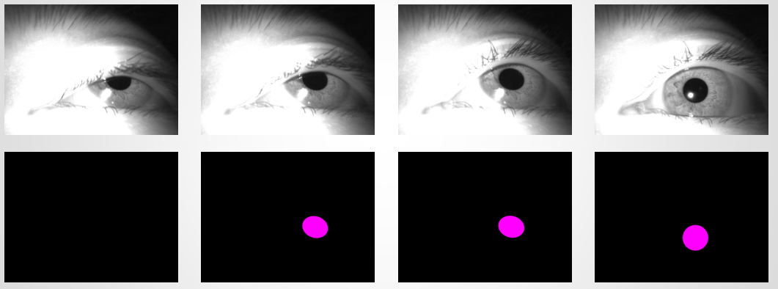
Solution Approach
Pupil Tracking
1. Segmentation
2. Classification (only output 0/1)

Slide 5
2. Model Architecture: Segmentation
Segmentation model experiment
Model | S5 all 1 conf
Unet | 0.648
Att_unet | X
DeeplabV3_resnet101 | 0.638
DeeplabV3_hrnet | X
Segformer | 0.630
RITnet | 0.659

Slide 6
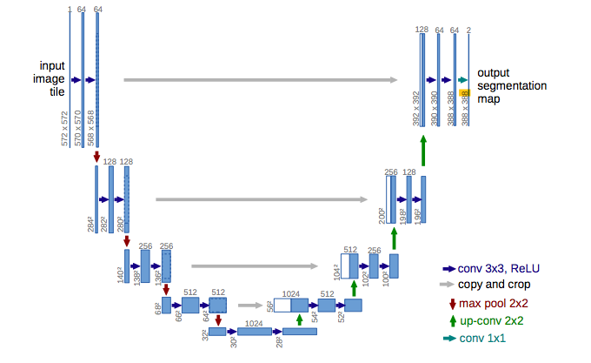
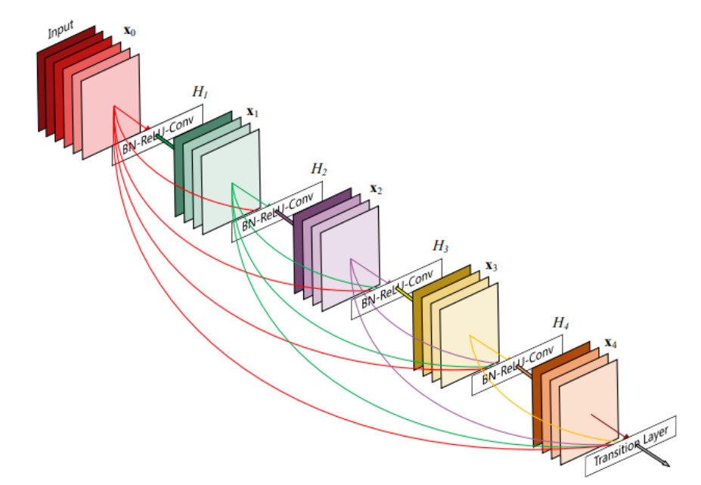
2. Model Architecture: Segmentation
RITnet model combines U-Net and DenseNet
Unet
DenseNet

Slide 7
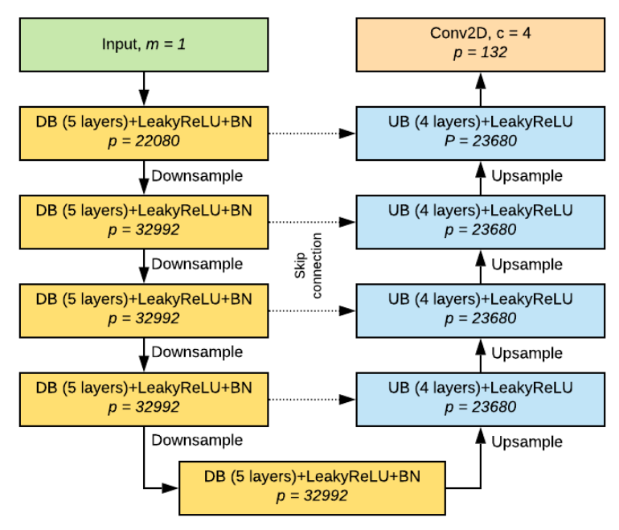
2. Model Architecture: Segmentation
RITnet model combines U-Net and DenseNet
RITnet

Slide 8
2. Model Architecture: Confidence
Use Efficient-net as classifier
Experient different Efficient net with same segmentation model
Efficient-net | S5
B0 | 0.9382
B1 | 0.9469
B2 | 0.936

Slide 9
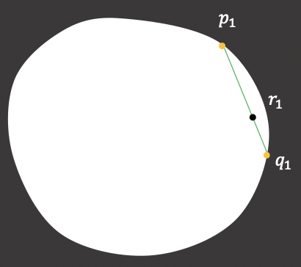
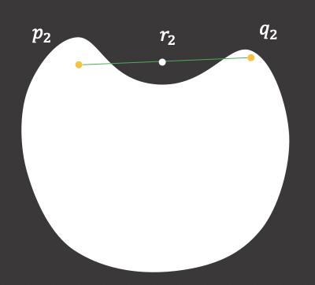
3. Loss function – Segmentation (Unet)
One dimension output. e.g. (1,1,480,640)
BCEWithLogitsLoss
pos_weight=25
TverskyLoss
(alpha=0.8, beta=0.2)
Shape loss
Refer to Noise-Robust Pupil ... With Shape-Prior Loss
make shape Convex Polygon
Performance (Unet, no gamma):
Overall weighted IoU: 0.6619
Average true negative rate: 0.4875
Benchmark score: 0.6096 😵
Notes:
主要有兩種model在試, RITnet跟Unet，這邊loss function主要實作在Unet，然後Unet有兩種

Slide 10
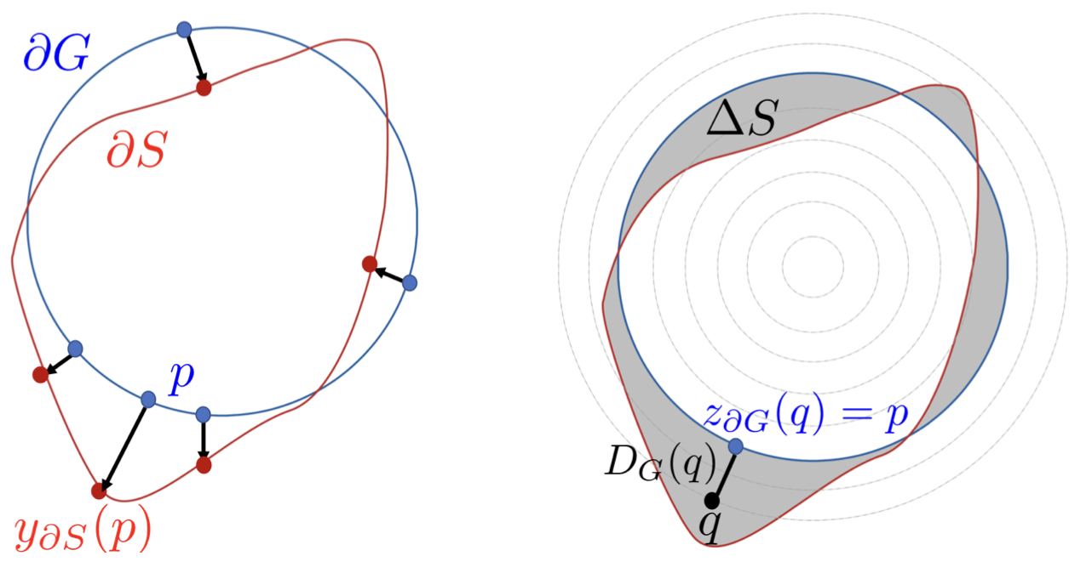
3. Loss function – Segmentation (Unet)
Two dimension output. e.g. (1,2,480,640)
CrossEntropyLoss
Dice loss
Boundary loss
Refer to https://www.sciencedirect.com/science/article/abs/pii/S13618415...
Performance (Unet):
Overall weighted IoU: 0.9307
Average true negative rate: 0.9874
Benchmark score: 0.9477 🤔

Slide 11
3. Loss function – Segmentation (Unet)
Boundary loss
If output far from edge → greater loss
0 | 0 | 0 | 0 | 0 | 0
0 | 1 | 1 | 0 | 0 | 0
1 | 1 | 1 | 1 | 1 | 0
0 | 1 | 1 | 1 | 0 | 0
0 | 1 | 0 | 0 | 0 | 0
0 | 0 | 0 | 0 | 0 | 0
1.41 | 1 | 1 | 1.41 | 2 | 2.23
1 | 0 | 0 | 1 | 1 | 1.41
0 | -0.41 | -0.41 | 0 | 0 | 1
1 | 0 | 0 | 0 | 1 | 1.41
1 | 0 | 1 | 1 | 1.41 | 2.23
1.41 | 1 | 1.41 | 2 | 2.23 | 3.16
gt mask
distmap

Slide 12
3. Loss function – Segmentation (Unet)
Boundary loss
If output far from edge → greater loss
0 | 0 | 0 | 0 | 0 | 0
0 | 1 | 1 | 0 | 0 | 0
1 | 1 | 1 | 1 | 1 | 0
0 | 1 | 1 | 1 | 0 | 0
0 | 1 | 0 | 0 | 0 | 0
0 | 0 | 0 | 0 | 0 | 0
1.41 | 1 | 1 | 1.41 | 2 | 2.23
1 | 0 | 0 | 1 | 1 | 1.41
0 | -0.41 | -0.41 | 0 | 0 | 1
1 | 0 | 0 | 0 | 1 | 1.41
1 | 0 | 1 | 1 | 1.41 | 2.23
1.41 | 1 | 1.41 | 2 | 2.23 | 3.16
gt mask
distmap

Slide 13
3. Loss function – Segmentation & Conf
The best seg model only use CrossEntropyLoss.
RITnet (remove images with black label)
The best conf model only use CrossEntropyLoss w/ weight = [0.9, 0.1].
Efficient-B1

Slide 14
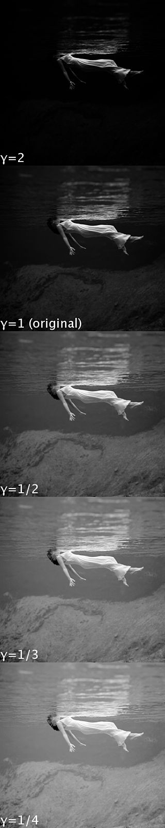
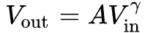
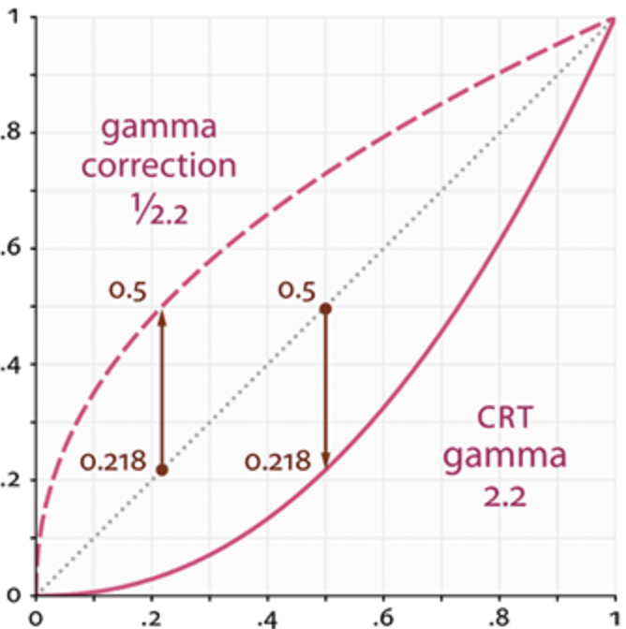
4. Data processing: Pre-processing
Gamma correction
Lighten or Darken the image
non-linear operation
Normalize to 0~1
Rescale to 0~255
γ<1: lighten
γ>1: darken

Slide 15
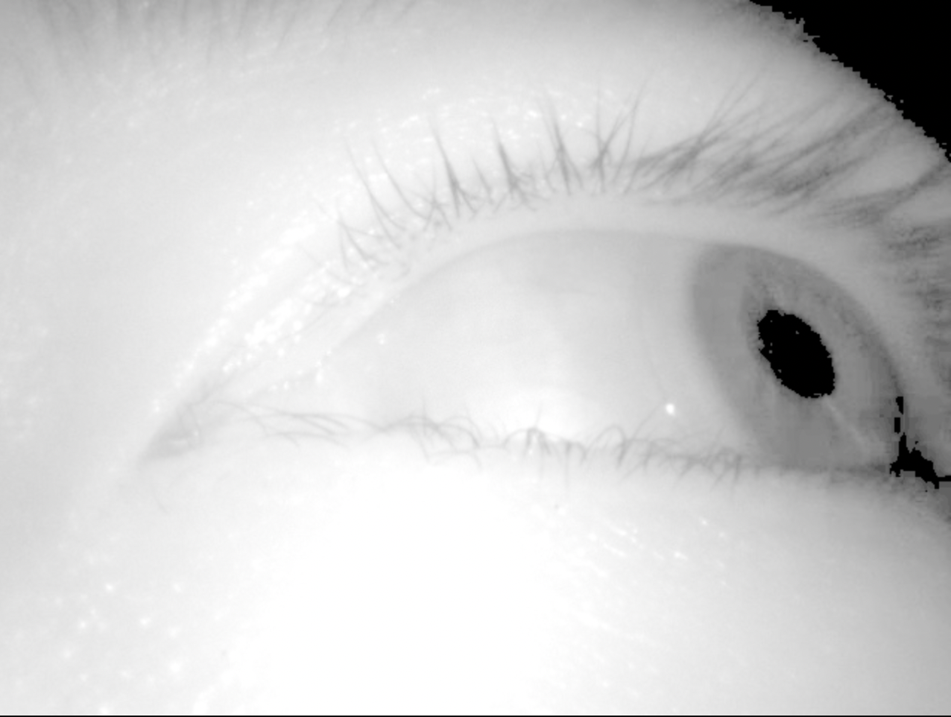
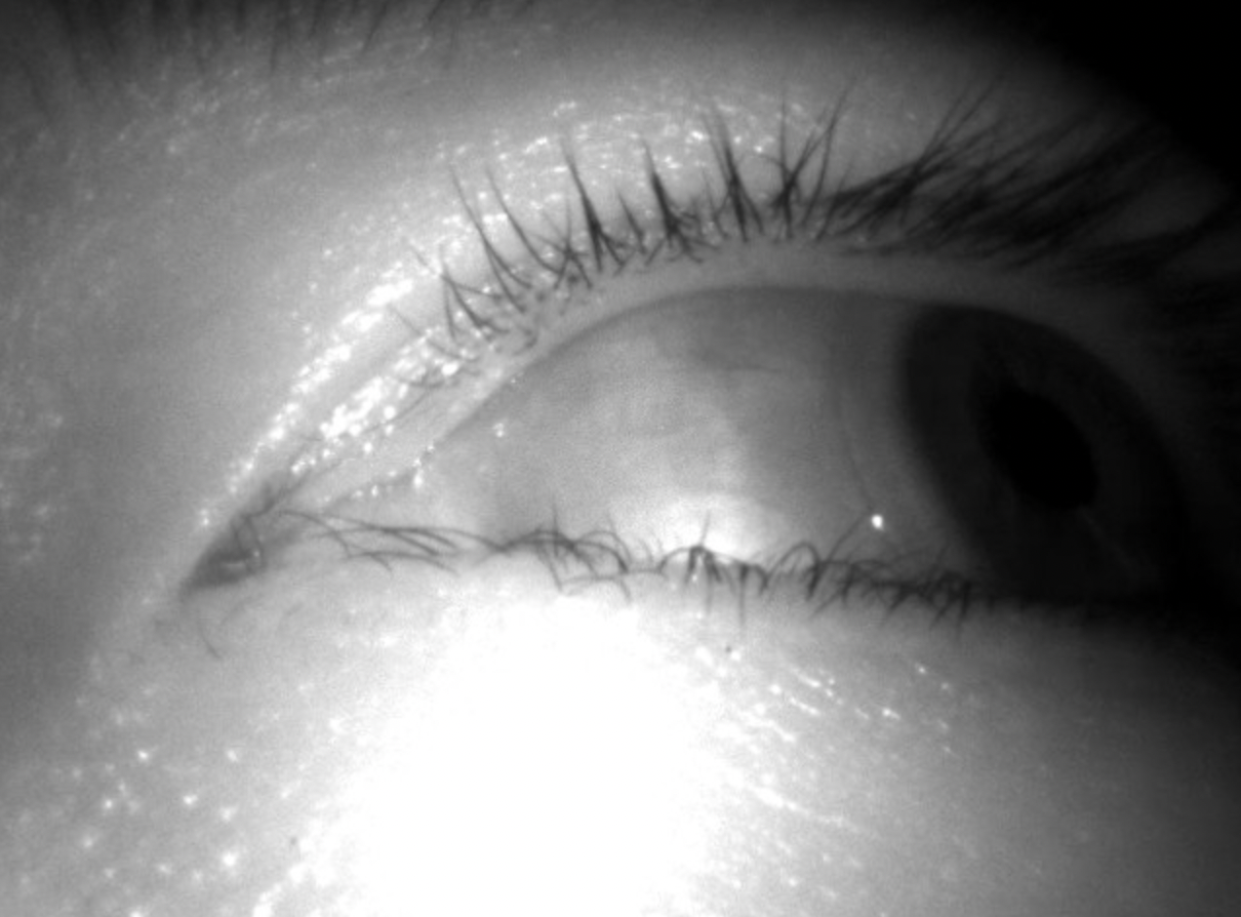
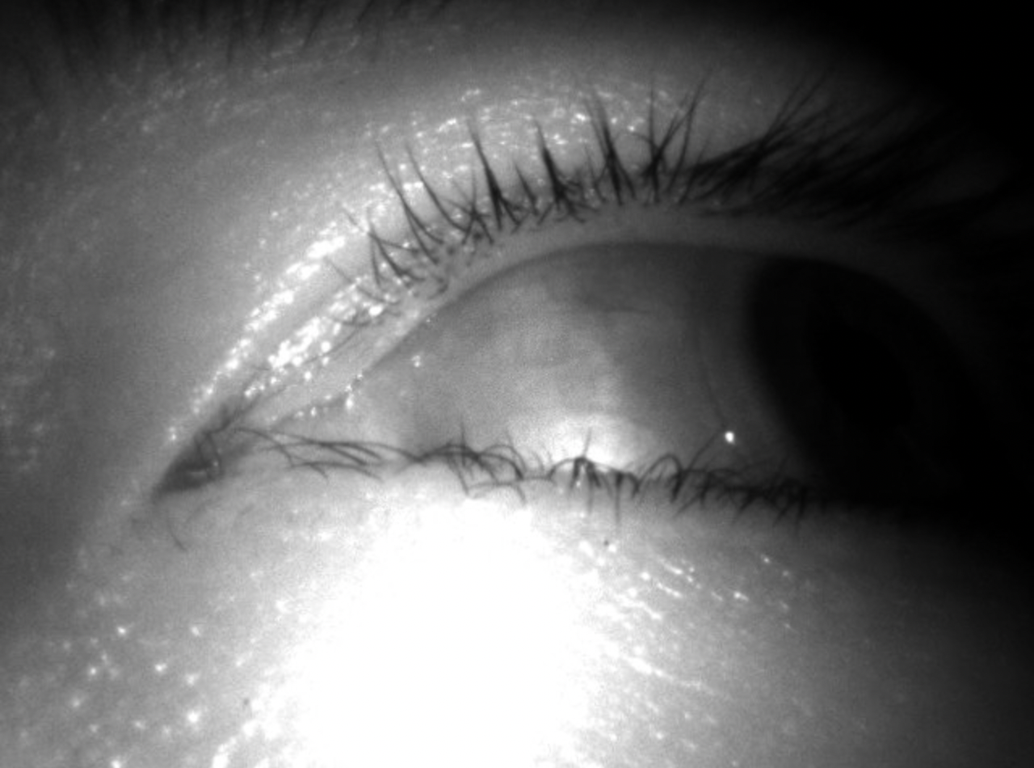
4. Data processing: Pre-processing
Gamma correction
S5/01/109.jpg
gamma=0.2
gamma=1
gamma=1.4

Slide 16
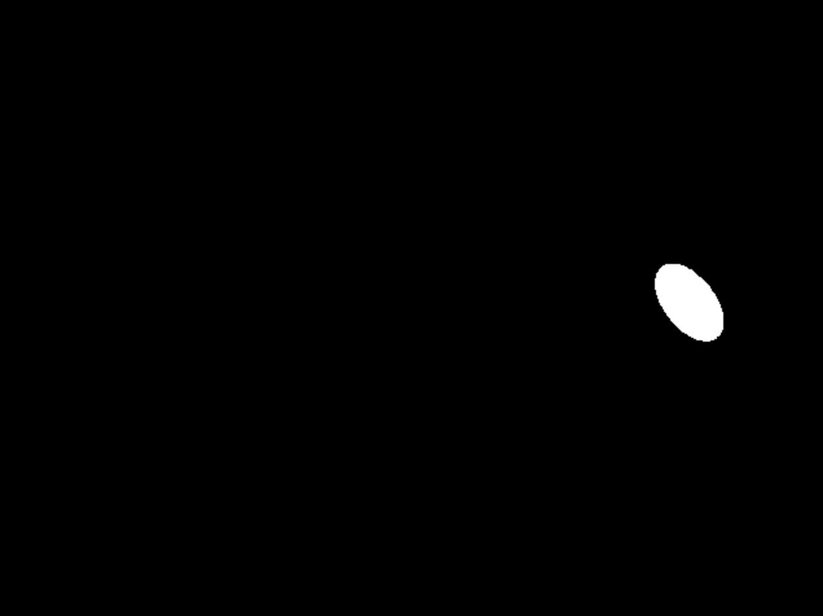
4. Data processing: Pre-processing
Gamma correction
S5/01/109.jpg
By cv2
cv2.approxPolyDP
cv2.morphologyEx
cv2.findcountour
cv2.fitEllipse
cv2.ellipse
But using DL is more robust

Slide 17
4. Data processing: Pre-processing
Gamma correction
gamma=0.4
Normalization
mean, std = [0.5, 0.5]

Slide 18
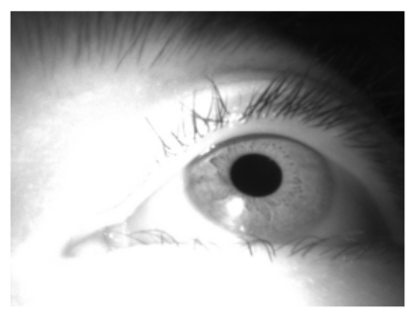
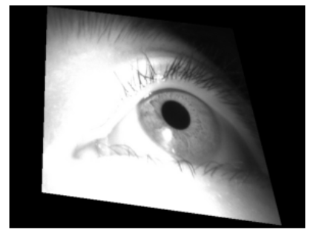
4. Data processing: Data augmentation
Refer to EllSeg
Gaussian Blur
kernel_size = [3, 5, 7]
sigma = [1, 2, 3, 4, 5]
Gaussian Noise
sigma = [0.02, 0.03, 0.04, 0.05, 0.06, 0.07, 0.08]
Position transform (all random)
a. Rotation (± 15°)
b. HorizontalFlip
c. Translation
d. Perspective transformation

Slide 19






4. Data processing: Post-processing (segmentation)
closing
hole filling, smooth
fit_ellipse
ground-truth is marked using ellipse tool
raw→closing→fit_ellipse
s5/01/20
s5/01/22
Notes:
pupil image is not ellipse (from Noise-Robust Pupil Center Detection Through CNN-Based Segmentation With Shape-Prior Loss )

Slide 20
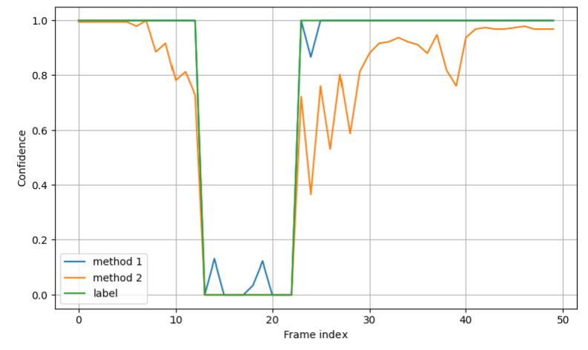
4. Data processing: Post-processing (confidence)
Smoothen the TNR curve

Slide 21
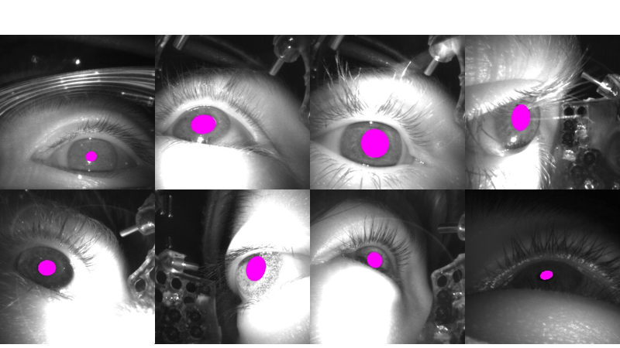
5. Challenge dataset - HM
successful cases

Slide 22
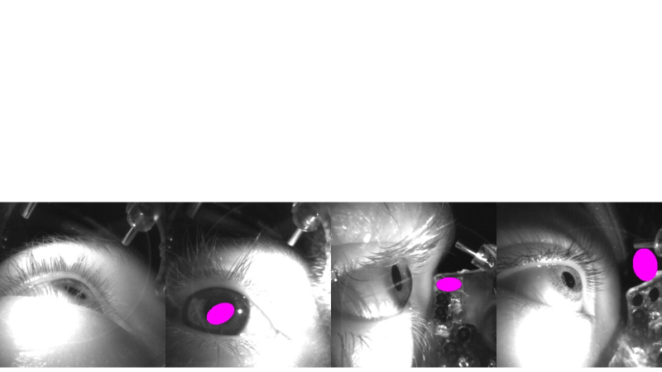
5. Challenge dataset - HM
failure cases
eyelash occlusion
similar color
pupil-like pattern

Slide 23
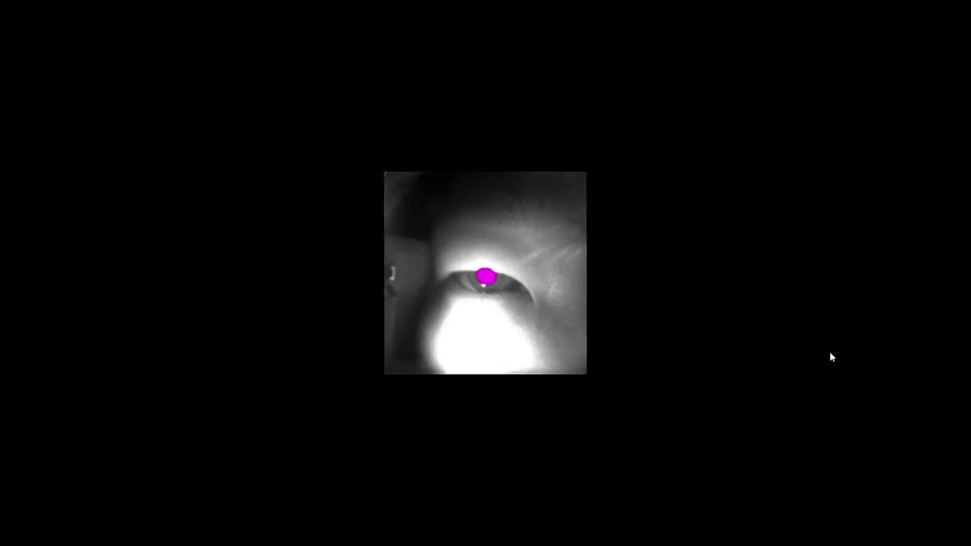
5. Challenge dataset - KL

Slide 24
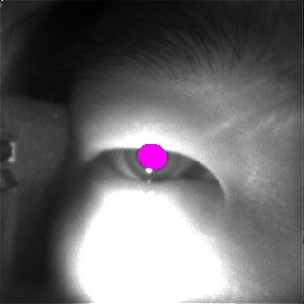
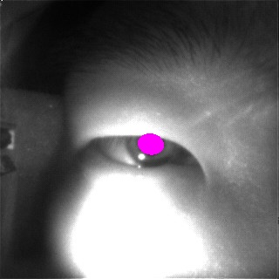
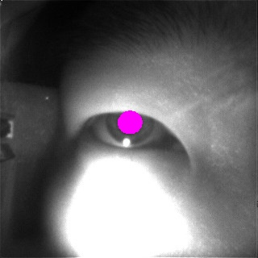
5. Challenge dataset - KL
successful cases

Slide 25
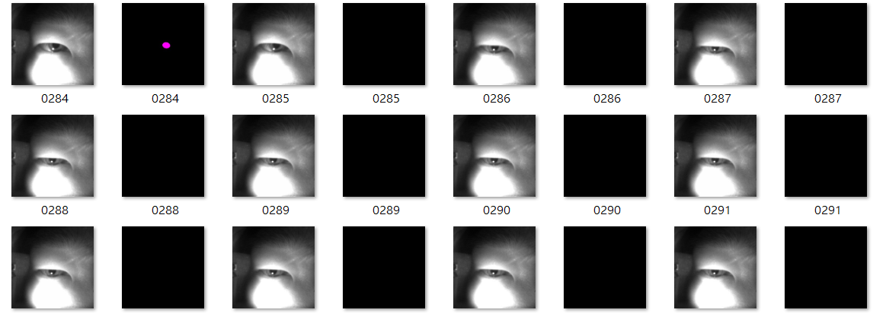
5. Challenge dataset - KL
failure cases

Slide 26
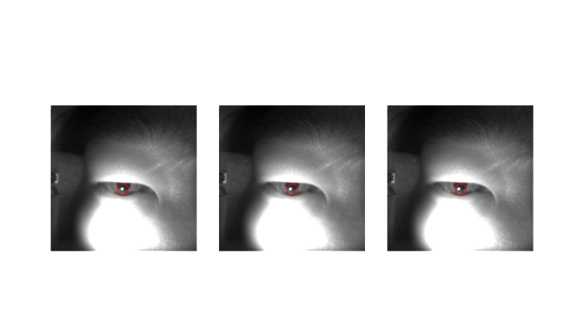
5. Challenge dataset - KL
failure cases - little bright spot on pupil

Slide 27
Thank you!

Slide 28
6. Reference
https://ieeexplore.ieee.org/document/9055424
https://github.com/jaegal88/pupil-shape-prior
https://arxiv.org/abs/1812.07032
https://github.com/yiskw713/boundary_loss_for_remote_sensing
https://arxiv.org/pdf/2007.09600.pdf
https://github.com/RSKothari/EllSeg
https://github.com/AayushKrChaudhary/RITnet/tree/master
https://www.kaggle.com/code/bigironsphere/loss-function-library-keras-pytorch/notebook
https://jason-chen-1992.weebly.com/home/-gamma-correction
https://blog.csdn.net/weixin_41693877/article/details/121370452
https://zhuanlan.zhihu.com/p/72783363

